Slide 1
Study for “exemplary” finding CAR# 143914008 – Team

Slide 2
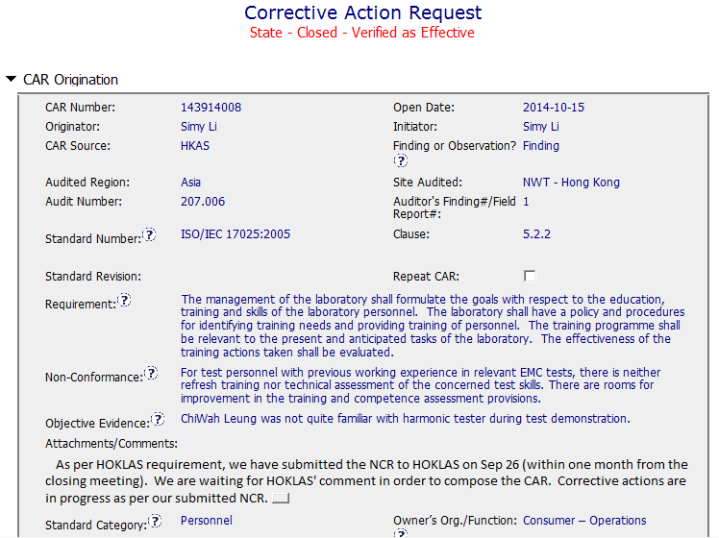
CAR 143914008 - Finding
Clearly identified the Requirement, non-conformance, Objective Evidence.
Clearly made a note to describe the status of CAR response.
Collaboration (L) : Keep others informed the status of CAR response to HOKLAS.

Slide 3
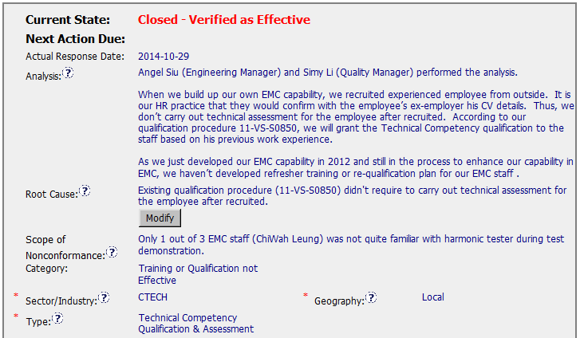
CAR 143914008 - Finding
Stakeholders identified
Analysis shows clear path to root cause and scope of NC
Root cause statement is brief and precise, reasonable, complete.
Most appropriate ‘category’, ‘type’, ‘geography’ are selected.
Integrity (T) : Most appropriate ‘category’, ‘type’, ‘geography’ are selected – Excellent
Competitiveness (C) : Analysis shows clear path to root cause and scope; stakeholders identified – Excellent
Competitiveness (C) : Root cause statement is succinct, reasonable, complete (Shows ‘N/A’ for observations) – Excellent

Slide 4
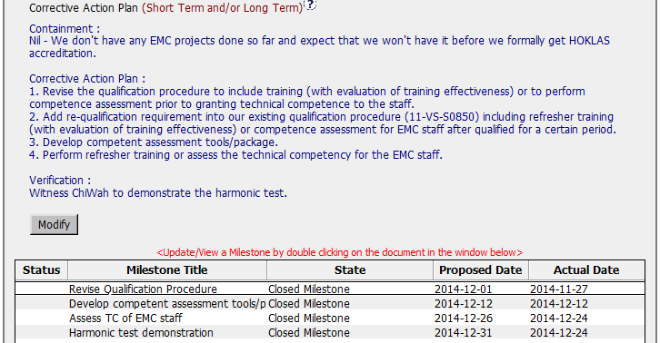
CAR 143914008 - Finding
CAP clearly documented “Containment”, “Corrective Actions” and “Verification”.
Corrective actions fix the objective evidence and other problems found; address entire root cause and scope of NC
Milestones address Corrective Action Plan & owner’s verification
Competitiveness (C) : Corrective actions fix the objective evidence and other problems found; address entire root cause and scope. - excellent
Competitiveness (C) : Milestones address corrective actions & owner’s verification – excellent
Competitiveness (P) : Verification per requirements

Slide 5
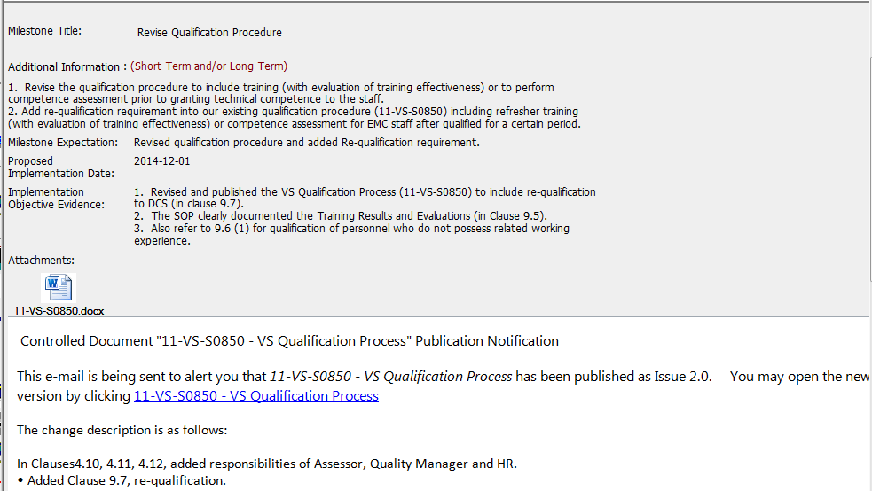
CAR 143914008 – Milestone 1
Milestones completed per milestone expectation.
The objective evidence is attached – Revised SOP was published to DCS
Competitiveness (C) : Milestones completed per milestone expectations - Excellent

Slide 6
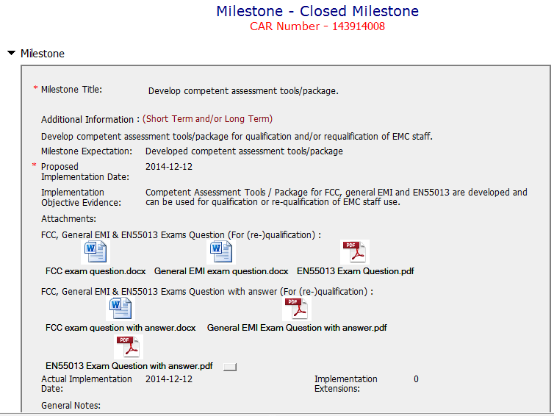
CAR 143914008 – Milestone 2
Milestones completed per milestone expectation.
The objective evidence is attached
Competitiveness (C) : Milestones completed per milestone expectations - Excellent

Slide 7
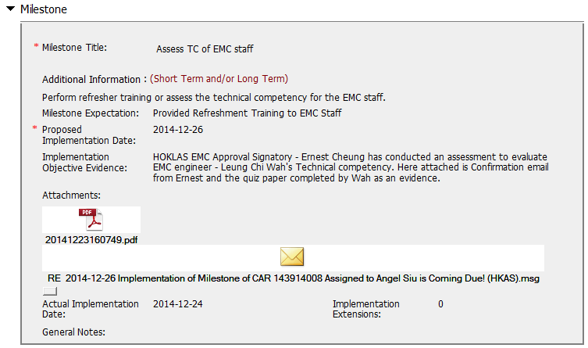
CAR 143914008 – Milestone 3
Milestones completed as per the intended CAP.
The objective evidence is attached
Competitiveness (C) : Milestones completed per milestone expectations - Moderate

Slide 8
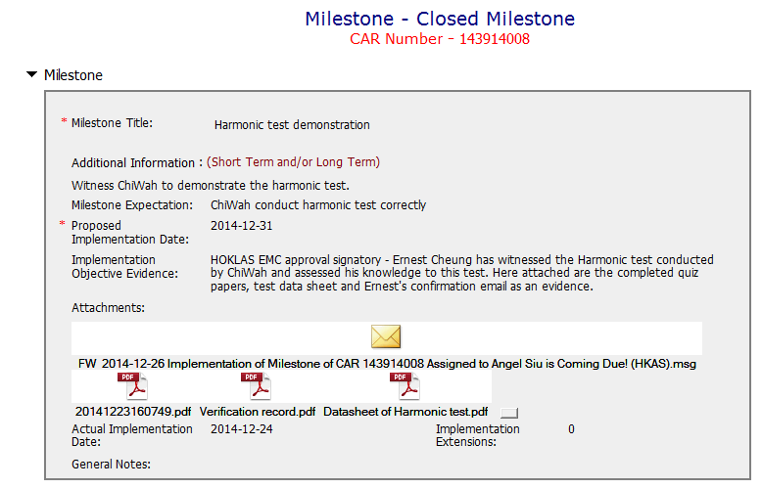
CAR 143914008 – Milestone 4 (Verification)
Milestones completed per milestone expectation.
The objective evidence is attached
Competitiveness (C) : Milestones completed per milestone expectations - Excellent

Slide 9
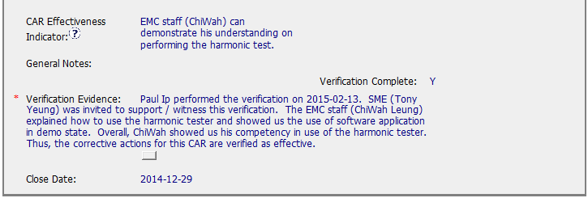
CAR 143914008 - Verification
Verification per CAR Effectiveness Indicator
Competitiveness (P) : Verification per requirements - Excellent

Slide 10
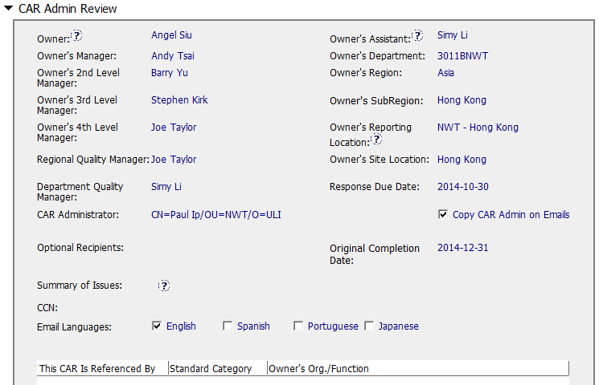
CAR 143914008 – CAR Admin Review
Correct input of Owner’s reporting manager.

Slide 11
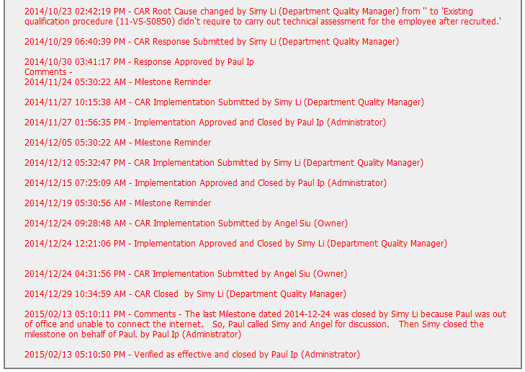
CAR 143914008 – History Review
Acts on CARs within required timeframe.
Timely deal with CAR owner’s response and submission.
Evidence of communications for clarification of CAR backup while the CAR Champion was absent.
Integrity (T) : Acts on CARs within required timeframe – Excellent
Competitiveness (C) : No Extensions, No escalated, No disputed – Excellent
Competitiveness (C L) : Evidence of communications per pertinent concerns - Excellent

Slide 12
CAR 143914008 – CBS Check
CBS Requirements | Excellent | Moderate | Need Improve | N/A
(C) Extensions are within requirement (<30 days, 3 or less) |  |  |  | X
(T) Most appropriate ‘category’, ‘type’, ‘geography’ are selected | X
(P) Facilitates the handling of disputed CARs |  |  |  | X
(T) Acts on CARs within required timeframe | X
(C) Analysis shows clear path to root cause and scope; stakeholders identified | X
(C) Root cause statement is succinct, reasonable, complete (Shows ‘N/A’ for observations) | X
(C) Corrective actions fix the objective evidence and other problems found; address entire root cause and scope. For observations, they do not go beyond fixing the objective evidence | X
(C) Milestones address containment & owner’s verification; completed per milestone expectations | X
(P) Verification per requirements | X
(L) Referenced communications are attached as needed | X
(C L) Evidence of communication for overdue/escalated CARs and other pertinent concerns | X
(P) Trains other CAR Champions |  |  |  | X

